Slide 1
University American College Skopje
Course: Business Computer Applications
Basics in Artificial Intelligence
Marija Stanojeska, PhD

Slide 3
Lecture overview
Explanation of the Artificial Intelligence (AI) concept.
Discussion the differences between AI, Machine Learning and Deep Learning.
Description the types of AI.
Description the components of AI.
Presentation of scope of AI.
Discussion the advantages and disadvantages of AI.
Discussion the challenges of Ai.

Slide 4
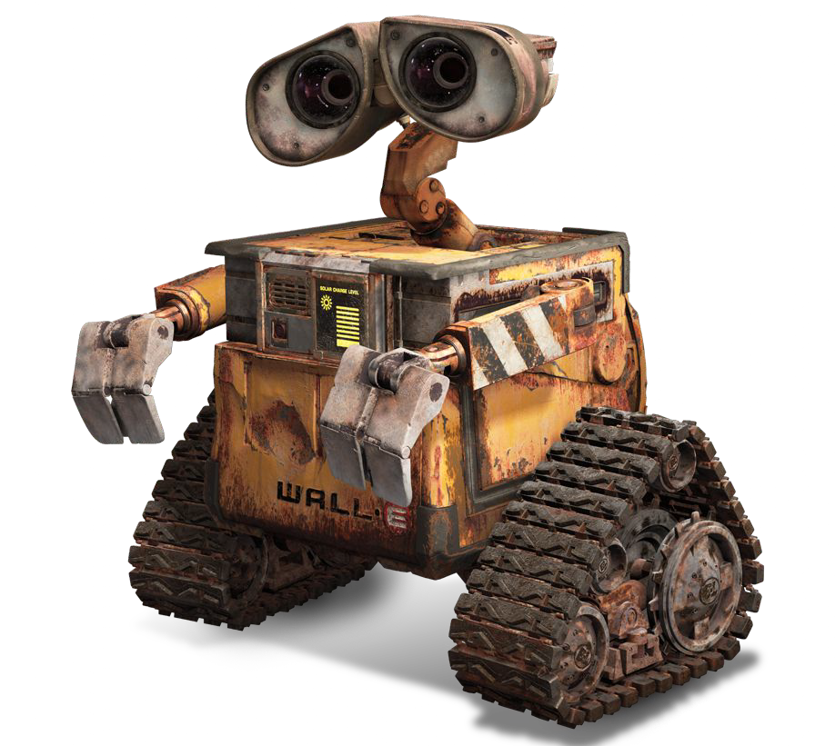
Artificial Intelligence in Movies
In movies, robots are able to talk, think, have emotions, and make decisions just like humans.

Slide 5
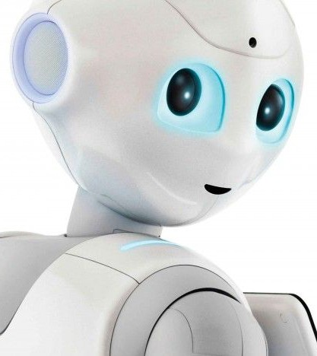
What is Artificial Intelligence?
“The science and engineering of making intelligent machines”
John McCarthy, Father of AI, (1956).
Artificial intelligence is the simulation of human intelligence processes by machines, especially computer systems.
Specific applications of AI include expert systems, natural language processing, speech recognition and machine vision.

Slide 6
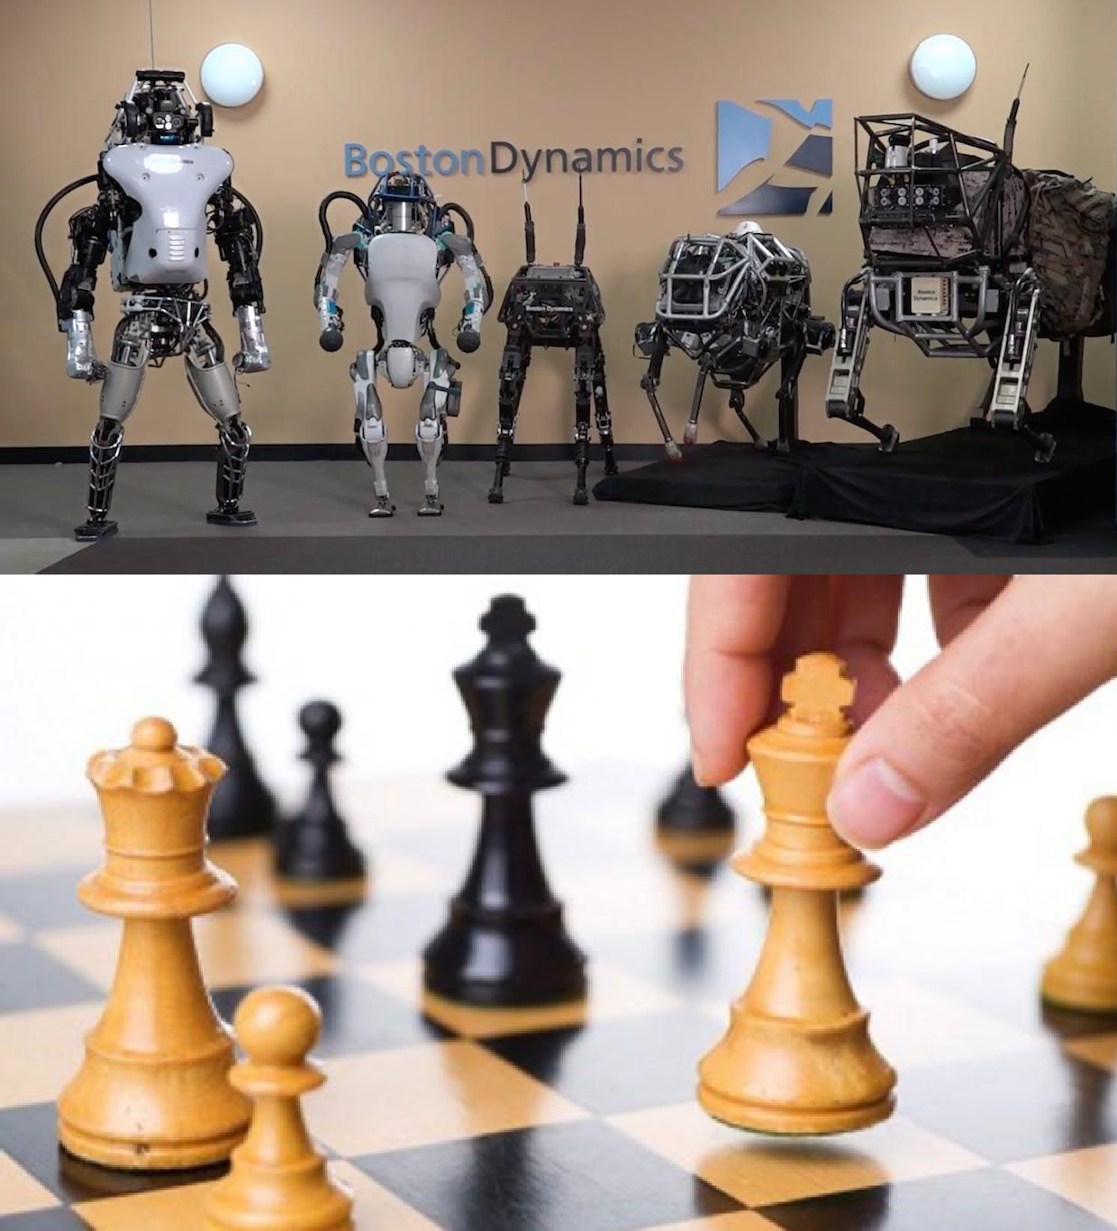
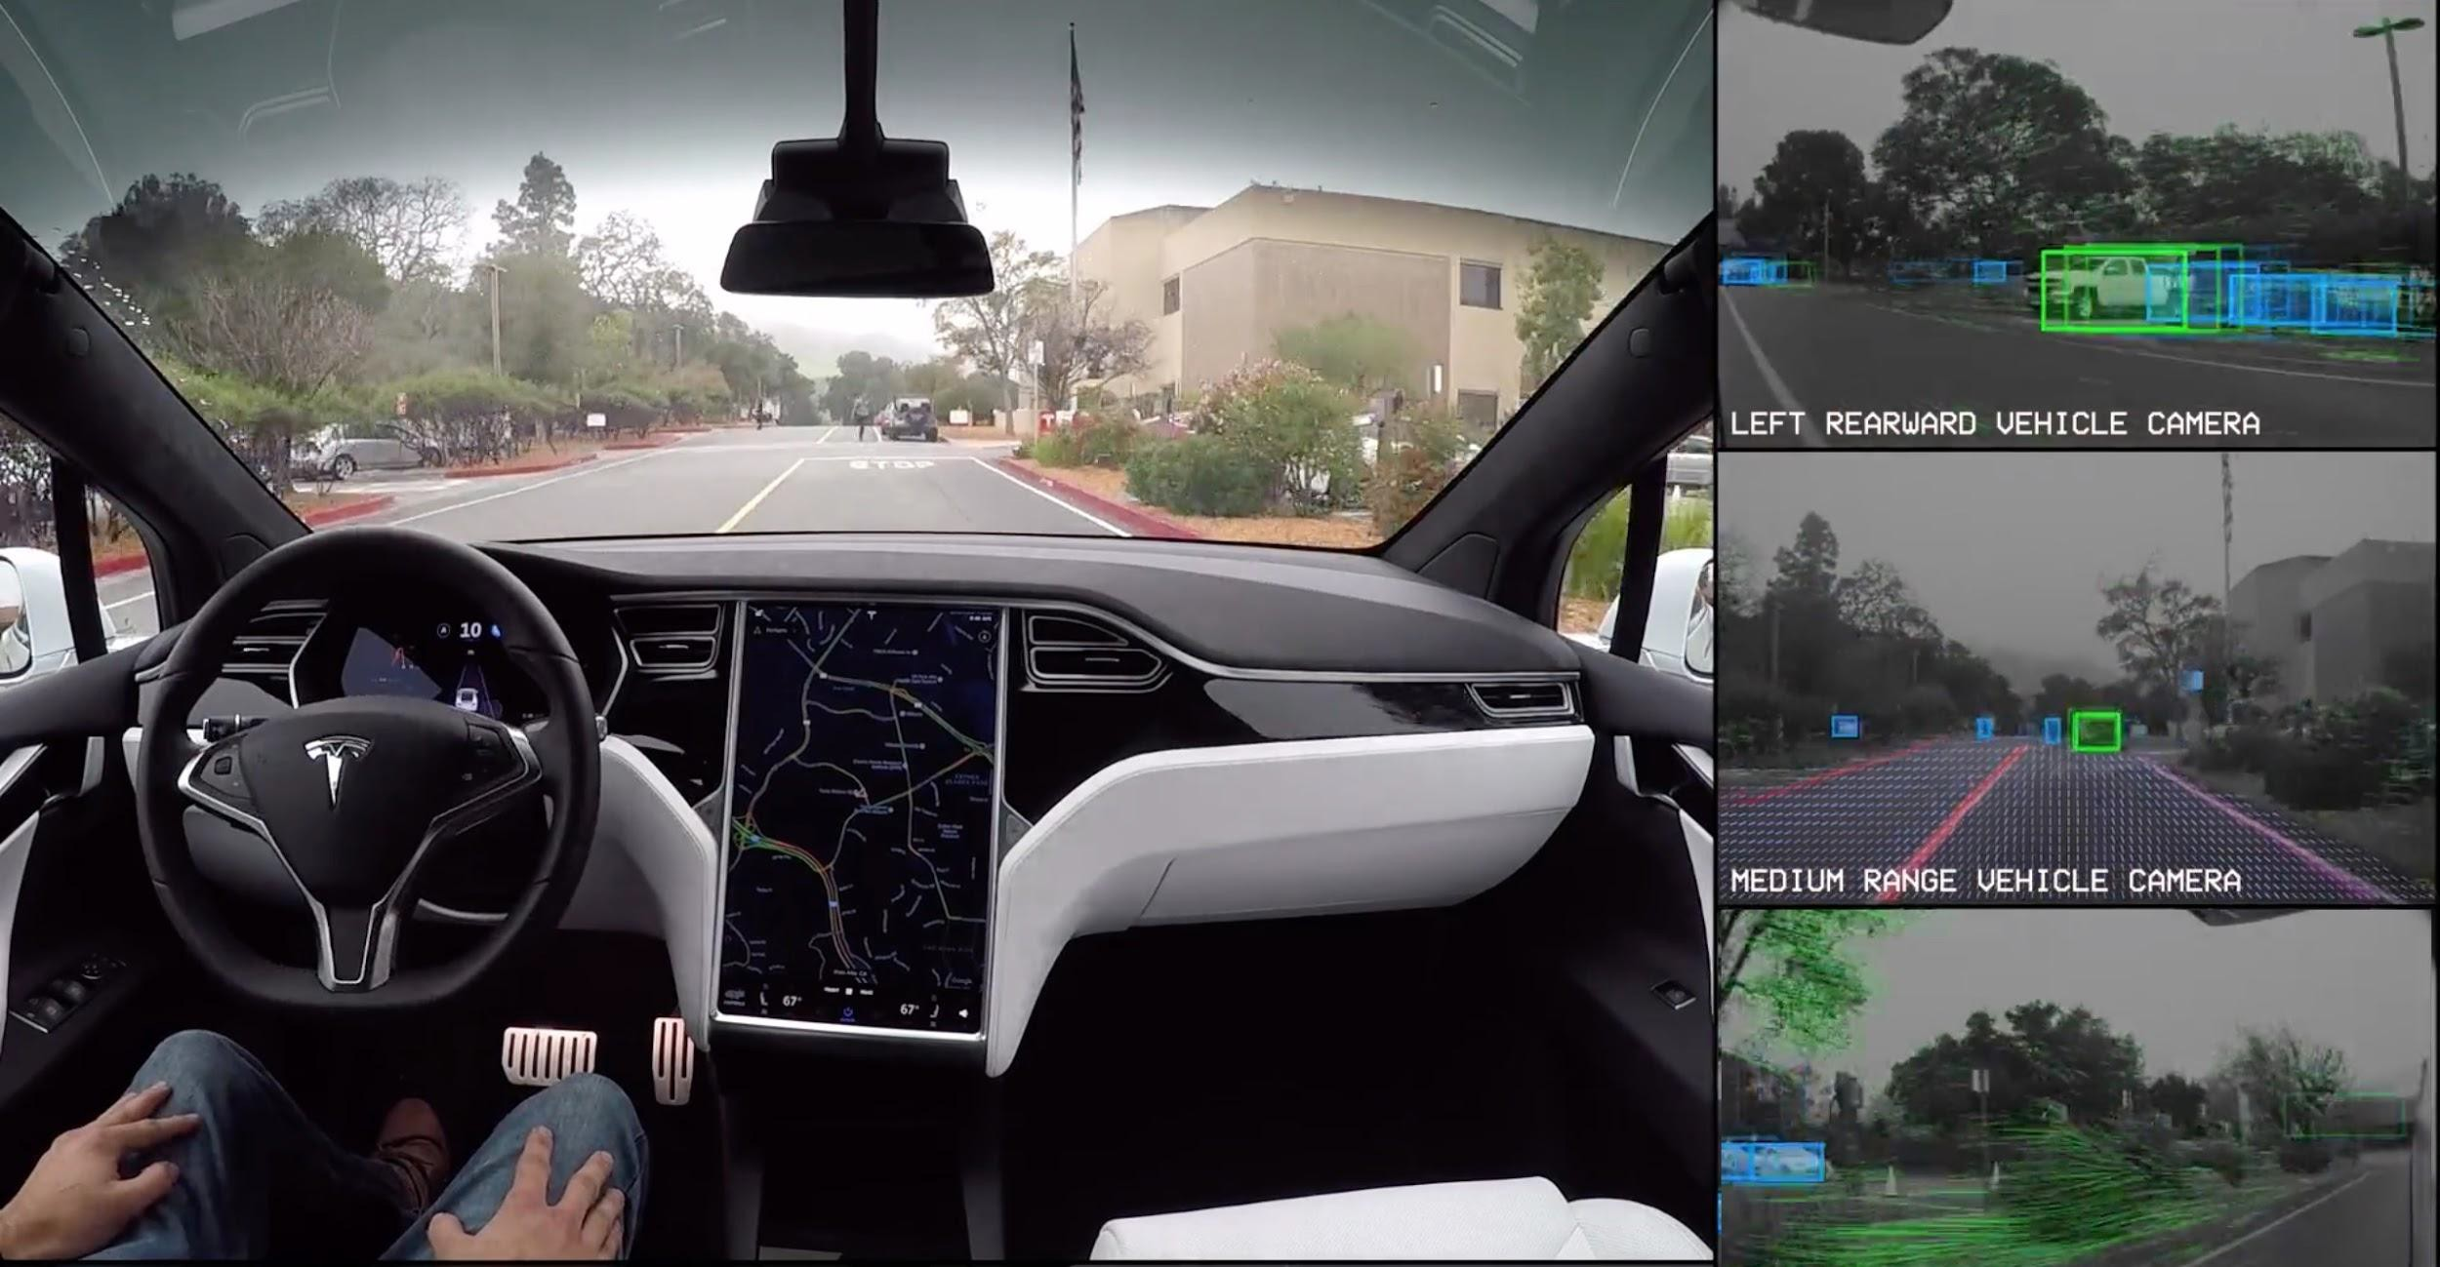
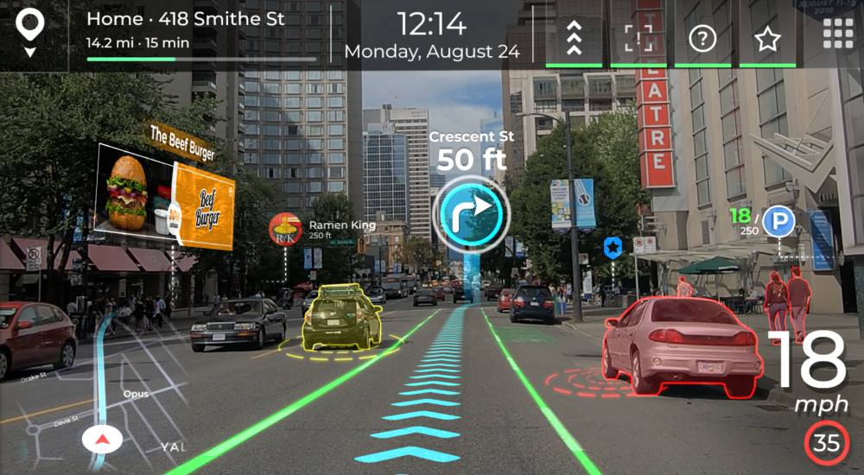

Real Life AI Examples
Self-driving cars
Humans vs. Computer games
Navigation Systems
Chatbots

Slide 7
Examples of AI technology
Automation. When paired with AI technologies, automation tools can expand the volume and types of tasks performed. An example is robotic process automation (RPA), a type of software that automates repetitive, rules-based data processing tasks traditionally done by humans. When combined with machine learning and emerging AI tools, RPA can automate bigger portions of enterprise jobs, enabling RPA's tactical bots to pass along intelligence from AI and respond to process changes.
Machine learning. This is the science of getting a computer to act without programming. Deep learning is a subset of machine learning that, in very simple terms, can be thought of as the automation of predictive analytics.
Machine vision. This technology gives a machine the ability to see. Machine vision captures and analyzes visual information using a camera, analog-to-digital conversion and digital signal processing. It is often compared to human eyesight, but machine vision isn't bound by biology and can be programmed to see through walls, for example. It is used in a range of applications from signature identification to medical image analysis. Computer vision, which is focused on machine-based image processing, is often conflated with machine vision.

Slide 8
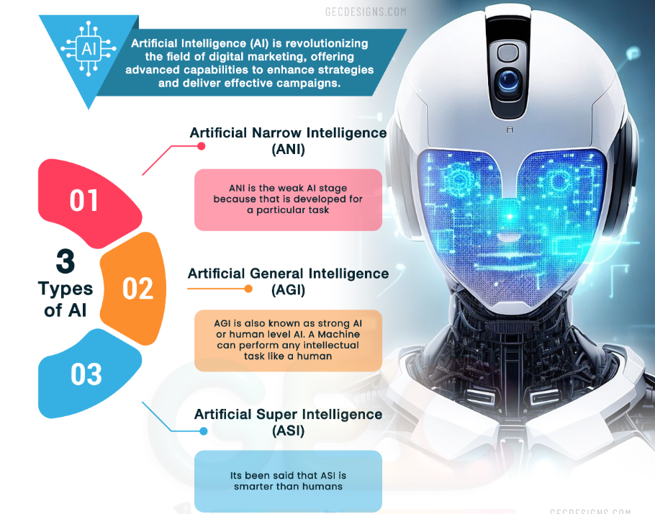
Types of AI

Slide 9
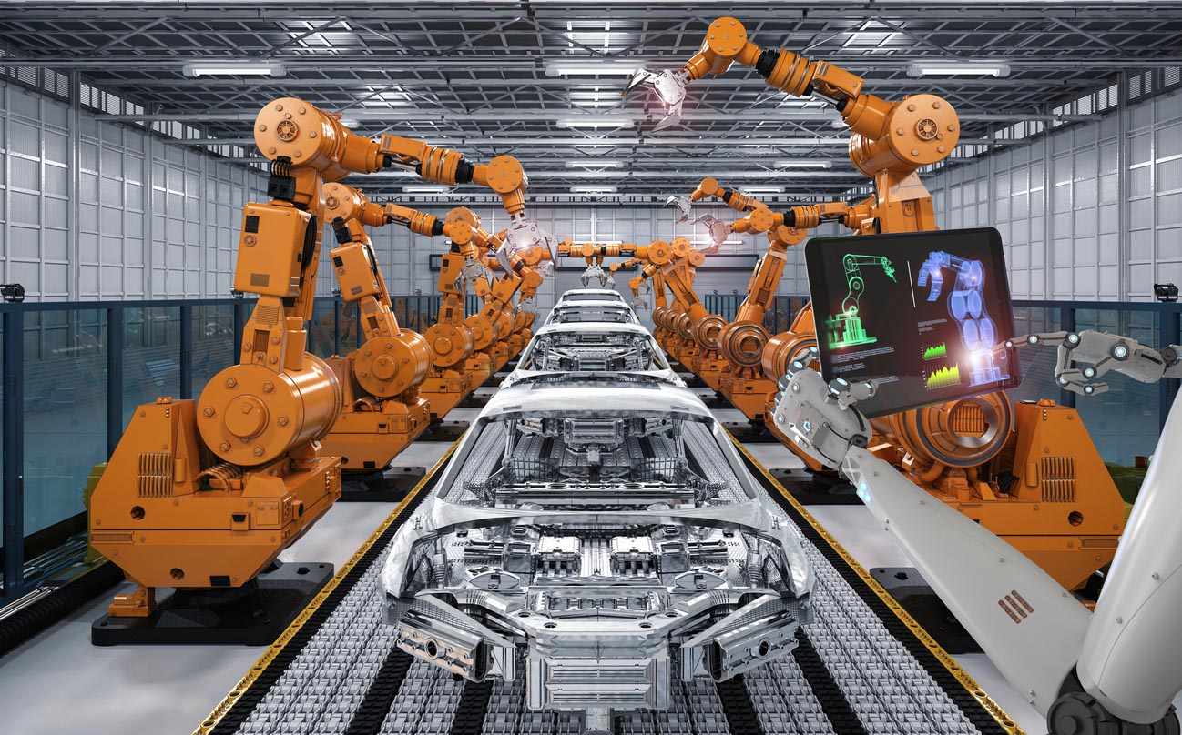
Artificial Narrow or Weak Intelligence (ANI/WAI)
This type of AI is designed to perform a specific task or a narrow range of tasks, typically with a high level of accuracy within its specific domain. ANI/WAI lacks general intelligence and is not capable of autonomous decision-making outside of its predefined scope. Examples of ANI/WAI include voice assistants like Siri, recommendation algorithms, and image recognition systems. Industrial robots and virtual personal assistants, such as Apple's Siri, use weak AI. Machines with week Artificial intelligence are made to respond to specific situation but can not think to themselves.

Slide 10
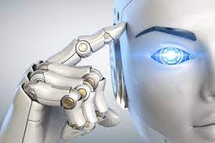
Artificial General Intelligence (AGI/SAI)
Artificial General Intelligence (AGI/SAI) possesses a level of intelligence comparable to human intelligence and is capable of understanding, learning, and applying knowledge across a wide range of tasks and domains. AGI/SAI has the ability to think, reason, and make decisions autonomously, exhibiting cognitive capabilities at or beyond human level. AGI/SAI, if achieved, could potentially perform any intellectual task that a human can. It describes programming that can replicate the cognitive abilities of the human brain. When presented with an unfamiliar task, a strong AI system can use fuzzy logic to apply knowledge from one domain to another and find a solution autonomously.
A machine with strong AI is able to think and act just like a human. It is able to learn experiences. The best representation would be how Hollywood portrays robots.
However, true AGI/SAI is still a hypothetical concept and has not yet been fully realized.

Slide 11
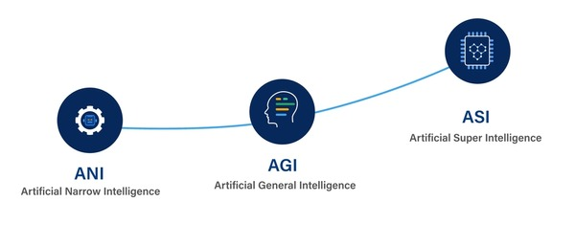
Artificial super intelligence (ASI)
Artificial super intelligence (ASI) surpasses human intelligence and possesses capabilities that are vastly superior to human intelligence in all aspects. ASI, if achieved, would have the capacity to outperform humans in virtually all domains of intellectual tasks and possess unprecedented levels of problem-solving, decision-making, and creative abilities. ASI is considered highly speculative and its potential implications, benefits, and risks are the subject of extensive debates and discussions among researchers, ethicists, and policymakers

Slide 12
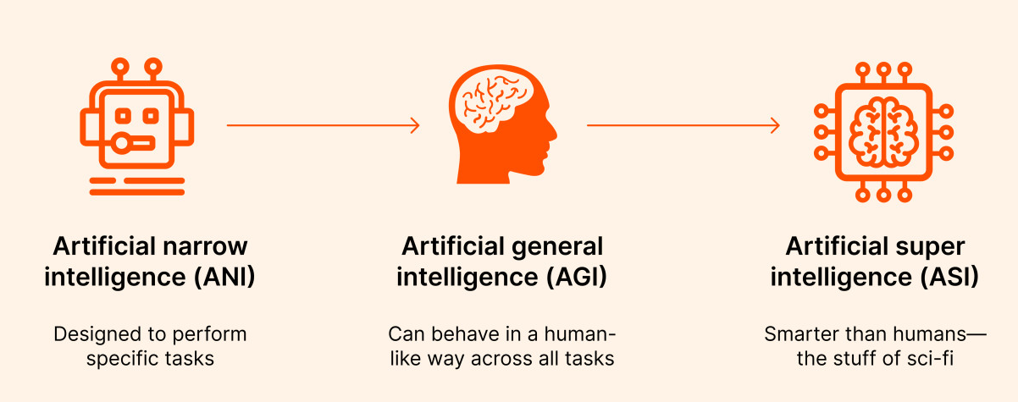
ANI vs. AGI vs. ASI

Slide 13
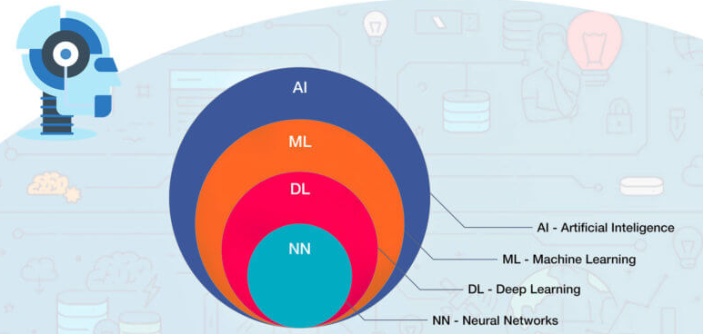
Differences between AI, Machine Learning and Deep Learning
The term AI, coined in the 1950s, refers to the simulation of human intelligence by machines. It covers an ever-changing set of capabilities as new technologies are developed. Technologies that come under the umbrella of AI include machine learning and deep learning.
Machine learning enables software applications to become more accurate at predicting outcomes without being explicitly programmed to do so. Machine learning algorithms use historical data as input to predict new output values. This approach became vastly more effective with the rise of large data sets to train on.
Deep learning, a subset of machine learning, is based on our understanding of how the brain is structured. Deep learning's use of artificial neural networks structure is the underpinning of recent advances in AI, including self-driving cars and ChatGPT.

Slide 14
Differences between AI, Machine Learning and Deep Learning (cont.)
Artificial Intelligence | Machine Learning | Deep Learning
The term Artificial intelligence was first coined in the year 1956 by John McCarthy. | The term ML was first coined in the year 1959 by Arthur Samuel. | The term DL was first coined in the year 2000 Igor Aizenberg.
It is a technology that is used to create intelligent machines that can mimic human behavior. | It is a subset of AI that learns from past data and experiences. | It is the subset of machine learning and AI that is inspired by the human brain cells, called neurons, and imitates the working of the human brain.
AI completely deals with structured, semi-structured data. | ML deals with structured and semi-structured data. | Deep learning deals with structured and unstructured data.
It requires a huge amount of data to work. | It can work with less amount of data compared to deep learning and AI. | It requires a huge amount of the data compared to the ML.
The goal of AI is to enable the machine to think without any human intervention. | The goal of ML is to enable the machine to learn from past experiences. | The goal of deep learning is to solve the complex problems as the human brain does, using various algorithms.

Slide 15
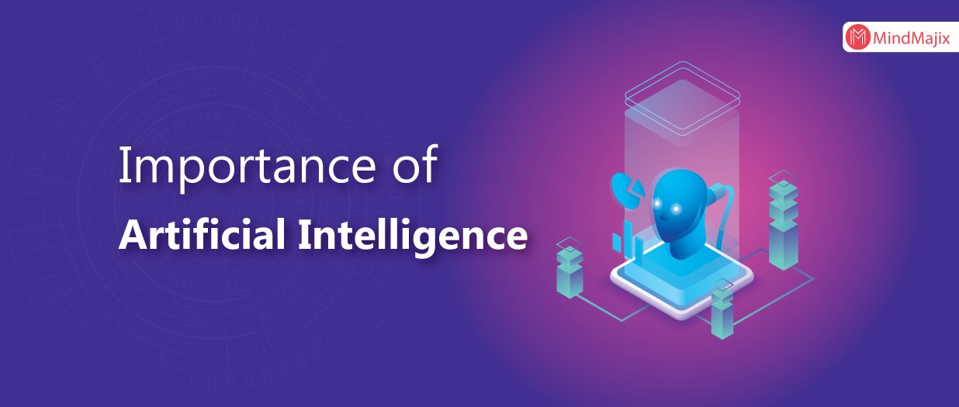
The importance of AI
AI is important for its potential to change how we live, work and play. It has been effectively used in business to automate tasks done by humans, including customer service work, lead generation, fraud detection and quality control.
In a number of areas, AI can perform tasks much better than humans. Particularly when it comes to repetitive, detail-oriented tasks, such as analyzing large numbers of legal documents to ensure relevant fields are filled in properly, AI tools often complete jobs quickly and with relatively few errors. Because of the massive data sets it can process, AI can also give enterprises insights into their operations they might not have been aware of.
The rapidly expanding population of generative AI tools will be important in fields ranging from education and marketing to product design.

Slide 16
Advantages of AI
Good at detail-oriented jobs. AI has proven to be as good or better than doctors at diagnosing some diseases.
Reduced time for data-heavy tasks. AI is widely used in data-heavy industries, including banking and securities, pharma and insurance, to reduce the time it takes to analyze big data sets. Financial services, for example, routinely use AI to process loan applications and detect fraud.
Saves labor and increases productivity. An example here is the use of warehouse automation, which grew during the pandemic and is expected to increase with the integration of AI and machine learning.
Delivers consistent results. The best AI translation tools deliver high levels of consistency, offering even small businesses the ability to reach customers in their native language.
Can improve customer satisfaction through personalization. AI can personalize content, messaging, ads, recommendations and websites to individual customers.
AI-powered virtual agents are always available. AI programs do not need to sleep or take breaks, providing 24/7 service.

Slide 17
Disadvantages of AI
Expensive.
Requires deep technical expertise.
Limited supply of qualified workers to build AI tools.
Reflects the biases of its training data, at scale.
Lack of ability to generalize from one task to another.
Eliminates human jobs, increasing unemployment rates.

Slide 18
The four types of AI
I. Reactive machines
These AI systems have no memory and are task-specific. An example is Deep Blue, the IBM chess program that beat Garry Kasparov in the 1990s. Deep Blue can identify pieces on a chessboard and make predictions, but because it has no memory, it cannot use past experiences to inform future ones.
II. Limited memory
These AI systems have memory, so they can use past experiences to inform future decisions. Some of the decision-making functions in self-driving cars are designed this way.
III. Theory of mind
Theory of mind is a psychology term. When applied to AI, it means the system would have the social intelligence to understand emotions. This type of AI will be able to infer human intentions and predict behavior, a necessary skill for AI systems to become integral members of human teams.
IV. Self-awareness
In this category, AI systems have a sense of self, which gives them consciousness. Machines with self-awareness understand their own current state. This type of AI does not yet exist.

Slide 19
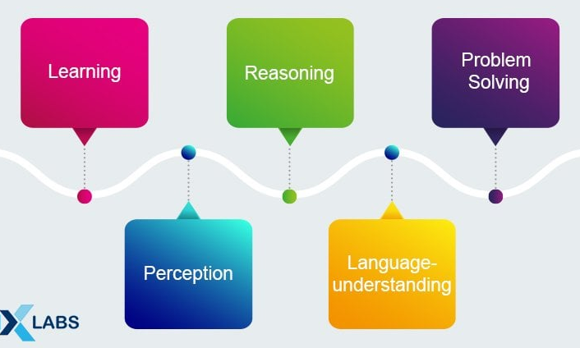
Components of AI

Slide 20
Components of AI
Learning
In the context of artificial intelligence (AI), the term "learning" refers to the ability of a system to improve its performance over time based on its experiences or exposure to data. These learning paradigms are often implemented using various algorithms and models, such as neural networks, decision trees, support vector machines, and more. Learning for AI includes the trial-and-error method. The solution keeps on solving problems until it comes across the right results. This way, the program keeps a note of all the moves that gave positive results and stores it in its database to use the next time the computer is given the same problem.
Additionally, within these paradigms, there are techniques like deep learning, which involves neural networks with many layers (deep neural networks), enabling them to learn complex patterns and representations.
Learning is a fundamental component of AI, and the choice of learning approach depends on the nature of the task and the type of data available for training the system.

Slide 21
Components of AI
Reasoning
In AI, reasoning refers to the process by which a system makes logical decisions or inferences based on available information. It involves the ability to analyze, interpret, and draw conclusions from data or knowledge. There are two main types of reasoning in AI:
Deductive Reasoning - drawing specific conclusions from general principles or rules.
Inductive Reasoning - making generalizations or predictions based on specific observations.
AI systems use predefined rules and knowledge bases to make logical decisions, similar to human experts in a particular field. Information is organized in a structured manner to facilitate logical reasoning processes within AI systems. AI models may incorporate probabilities to make more around decisions, especially in situations with uncertainty. AI systems follow logical rules to deduce new information or make predictions.
In essence, reasoning enables AI systems to think logically and make informed decisions, contributing to their problem-solving capabilities.

Slide 22
Components of AI
Problem Solving
Problem solving in AI involves a systematic approach to defining, representing, and solving complex problems through computational methods. In other words, problem solving in AI involves creating algorithms and models that enable machines to find solutions to complex issues or challenges.
The different methods of ‘Problem-solving’ count for essential artificial intelligence components that divide the requests into special and general purposes.
In the situation of a special-purpose method, the solution to a given problem is tailor-made, often exploiting some of the specific features provided in the case where a suggested problem is embedded. On the other hand, a general-purpose method implies a wide variety of issues.
Further, the problem-solving component in AI allows the programs to include step-by-step reduction of difference, given between any goal state and current state.
Examples of AI problem solving:
Search Algorithms: Used in navigating decision trees or exploring possible solutions.
Constraint Satisfaction Problems: Addressing problems with multiple constraints that need to be satisfied.
Optimization Algorithms: Finding the best possible solution among a set of alternatives.

Slide 23
Components of AI
Perception
Perception refers to the ability of a system to interpret and understand information from its environment. This involves gathering data from various sources and processing it to make sense of the world. The AI system interprets the processed information to form a meaningful understanding of its environment. This step involves linking patterns to known concepts or making sense of the context.
At its current state, perception is one of those components of artificial intelligence that can propel self-driving cars at moderate speeds. FREDDY was one of the robots at its earliest stage to use perception to recognize different objects and assemble different artifacts.
https://www.youtube.com/watch?v=lXJrXHDUQxo

Slide 24
Components of AI
Language understanding
Language processing in AI involves the development of algorithms and models that enable machines to understand, interpret, and generate human language.
Natural Language Understanding (NLU). Includes tasks such as sentiment analysis, named entity recognition, and understanding the context of a sentence.
Natural Language Generation (NLG). Focuses on the machine's ability to produce human-like language. This can involve generating coherent sentences, paragraphs, or even entire articles based on given input or data.
Speech Recognition. AI systems process and understand spoken language, converting audio signals into text. This enables applications like voice assistants and transcription services.
Text-to-Speech (TTS). Convert written text into spoken language. This technology is used in applications ranging from virtual assistants to accessibility tools for visually impaired individuals.
Machine Translation. AI is employed to automatically translate text or speech from one language to another. This facilitates cross-language communication and accessibility.
Dialog Systems. These systems enable machines to engage in natural language conversations. Chatbots and virtual assistants are examples of AI applications with dialog system capabilities.
Examples: Chatbots, Sentiment Analysis, Language Translation Services, Named Entity Recognition (NER).

Slide 25
Benefits of AI in business
Efficiency - AI tools automate time-consuming tasks, allowing employees to focus on more strategic activities.
Accuracy - reducing errors, particularly in areas like data entry, coding, and customer service.
Scalability - scale easily to handle growing business demands, whether it’s managing more customer inquiries or increasing production capacity.
Innovation - enabling businesses to experiment with new ideas and strategies at a lower cost.

Slide 26
Example: Chatbots by GOOGLE
Google has developed and released multiple AI-powered chatbots and virtual assistants.
Google Assistant: Google Assistant is a virtual assistant developed by Google that uses AI and natural language processing (NLP) to provide voice-based interactions with users. It is available on various devices, including smartphones, smart speakers, smart displays, and smartwatches, and can perform tasks such as answering questions, setting reminders, sending messages, making reservations, and controlling smart home devices.
Dialog flow: Dialog flow, formerly known as API.AI, is a platform developed by Google that allows developers to create conversational interfaces, including chatbots, using natural language understanding (NLU) and machine learning technologies. Dialog flow is commonly used by businesses to build chatbots for customer service, sales, and other applications.
Meena: Meena is a chatbot developed by Google Research as an AI language model. It is designed to generate human-like responses in conversations and engage in open-ended conversations on a wide range of topics. Meena uses deep learning techniques and large-scale language modeling to generate contextually relevant and coherent responses in conversations.
Google Chatbot for Business: Google also offers a chatbot for businesses, which is designed to help businesses automate customer support, handle inquiries, and provide information to users. It uses AI technologies to understand and respond to user queries in a conversational manner.

Slide 27
Challenges in implementing AI
Technical challenges
- Integrating AI with existing IT infrastructure, managing large datasets, and ensuring data quality.
Adoption barriers
Initial costs, lack of expertise, and resistance to change within organizations.
Ethical considerations
- Concerns about job displacement, decision-making transparency, transparency and accountability, and data privacy.

Slide 28
The future of AI in business
Emerging trends
Development of more sophisticated machine learning models, the rise of AI-powered decision-making tools, and the increasing integration of AI into everyday business processes.
AI-driven innovation
Huge number of innovation-driven opportunities in areas like personalized marketing, predictive analytics, and autonomous operations.
Impact on industries
Reshaping and transforming industries such as finance, healthcare, manufacturing, and retail, creating new opportunities and challenges.

Slide 29


Exercise
Try to provide an explanation on one of the following topics.
Who benefits from AI?
Who’s responsible for AI’s mistakes?
How to use artificial intelligence humanely?
What ethical considerations should be taken into account when implementing AI technologies?
In what industries can AI have the most significant positive impact, and how does it contribute to their development?
What steps can be taken to ensure transparency and accountability in AI decision-making processes?
What role does government regulation play in shaping the responsible use of AI, and what policies are currently in place or under consideration?
Present the findings in open-class discussion.

Slide 30
Useful links
Sources:
https://www.techtarget.com/searchenterpriseai/definition/AI-Artificial-Intelligence
https://www.analytixlabs.co.in/blog/components-of-artificial-intelligence/
https://www.javatpoint.com/artificial-intelligence-interview-questions
https://arxiv.org/ftp/arxiv/papers/2304/2304.05436.pdf
https://www.tidio.com/blog/benefits-of-chatbots/
https://www.zdnet.com/article/what-is-chatgpt-and-why-does-it-matter-heres-everything-you-need-to-know/
Videos:
Machine Learning and Human Bias
https://www.youtube.com/watch?v=59bMh59JQDo
How Cambridge Analytica Used Algorithms To Trawl Through Facebook User Data | Mach | NBC News
https://www.youtube.com/watch?v=olysFQkYkCA&t=16s

Slide 31
Thank you for your attention!

